Slide 1
Movie Analysis for Studio Development
Ryan S. Chung

Slide 2
OUTLINE
Business Problem
Summary of Project
Data and Methods
Business Insights
Results and Conclusion
Final Thoughts
Recommendations

Slide 3
Business Problem
With Microsoft deciding to create a new movie studio, the company is looking for insights on how to ensure its success.

Slide 4

Summary
In order to present Microsoft with the insights they are looking to collect. Several movie data sets were analyzed in order to confirm information that would prove useful in the creation of their new studio.
This power point will aim to explore the data provided and highlight significant findings.

Slide 5

Data and Methods Used
With the consolidation of several data sets consisted of various films, exploratory analysis was used to confirm several business problem related insights.
Question 1: What is the relationship between both domestic and world wide profit versus the allocated budget for movies?
Question 2: What is the relationship between the average rating and allocated budget for films?
Question 3: What does domestic and world wide profit look like relative to each month of the year?

Slide 6
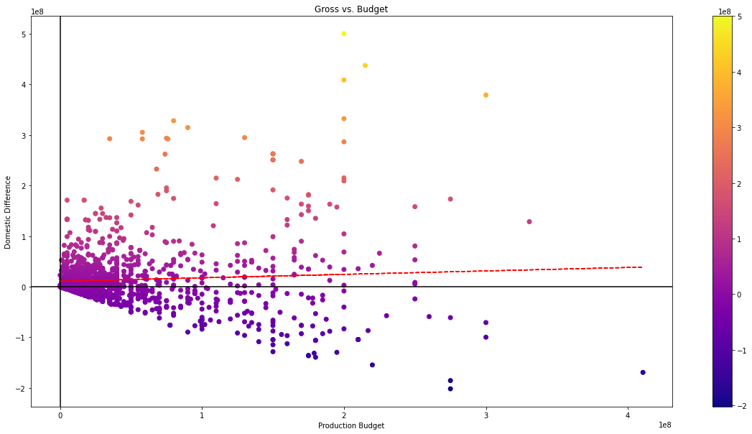
Insight #1
Looking at the relationship between the domestic profit of the films analyzed versus their allocated production budget, we can see there is a slight positive correlation.

Slide 7
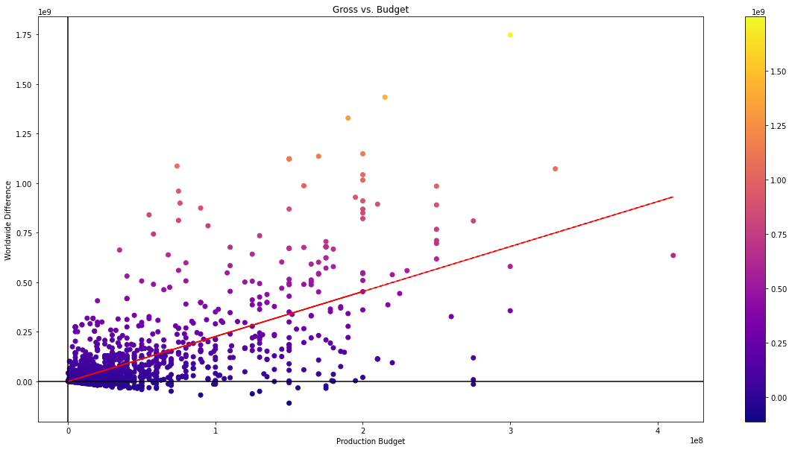
Insight #2
Looking at the relationship of all films world wide profit versus their allocated budget, we can see there is a much stronger positive correlation between the two items compared to the domestic profit v. budget relationship.

Slide 8
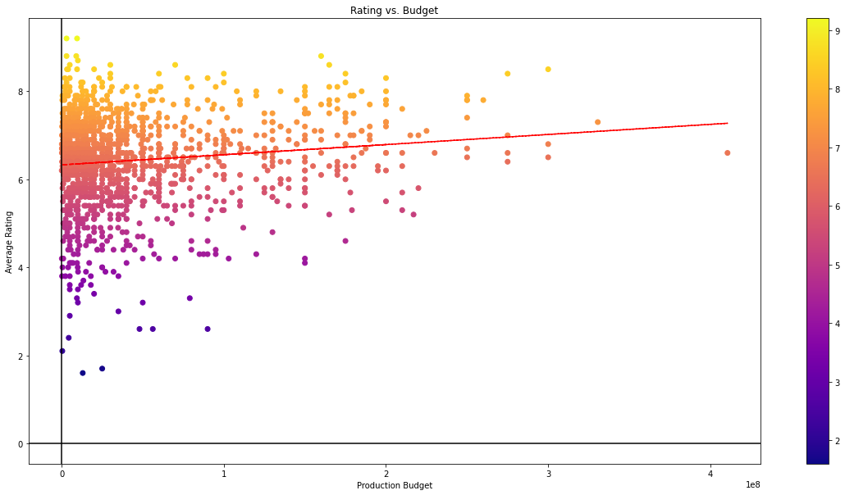
Insight #3
Next, taking a look at the average rating of movies versus their allocated production budget, there is a slight positive correlation between the two indicators.

Slide 9
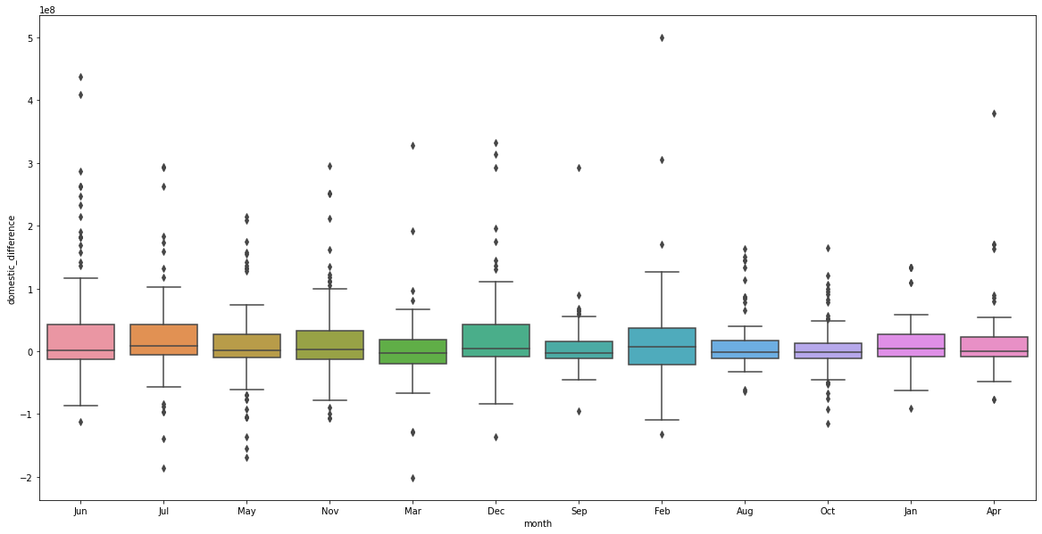
Insight #4
After analyzing the relationship between the domestic profit versus month of the year. It was found that May had the highest average domestic profit.

Slide 10
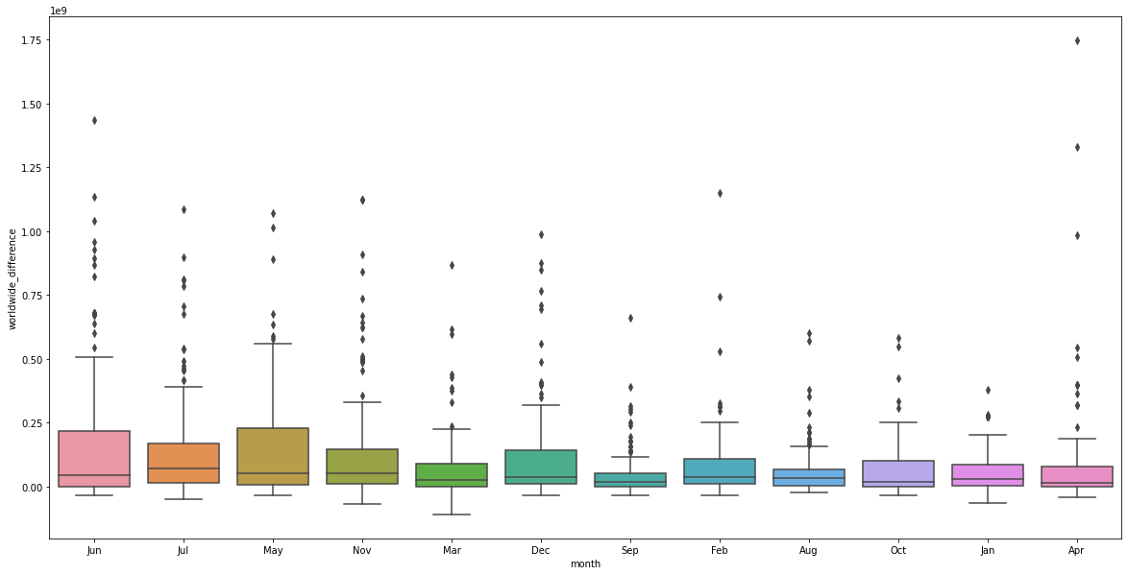
Insight #5
After analyzing the relationship between the world wide profit versus month of the year. It was found that August had the highest average world wide profit.

Slide 11
Further Analysis
In the last few slides, some important insights were highlighted to keep in mind for the development of the new studio. While that information is valid, further investigation brought forth several new items of note.
In the next few slides, the same questions initially asked for this project will be asked but the findings will be excluding all movies that did not have an overall profit for both the domestic profit and world wide profit categories.

Slide 12
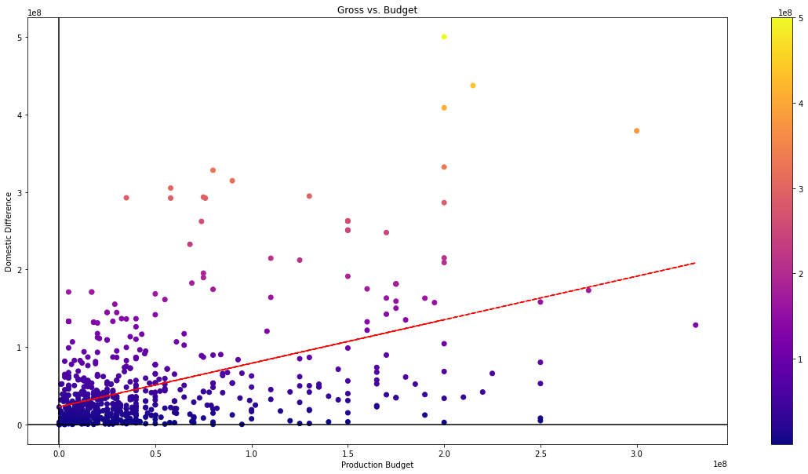
Insight #A
Now looking at the relationship of all films that had a domestic profit greater than zero versus their allocated budget, we can see there is a much stronger positive correlation between the two categories.

Slide 13
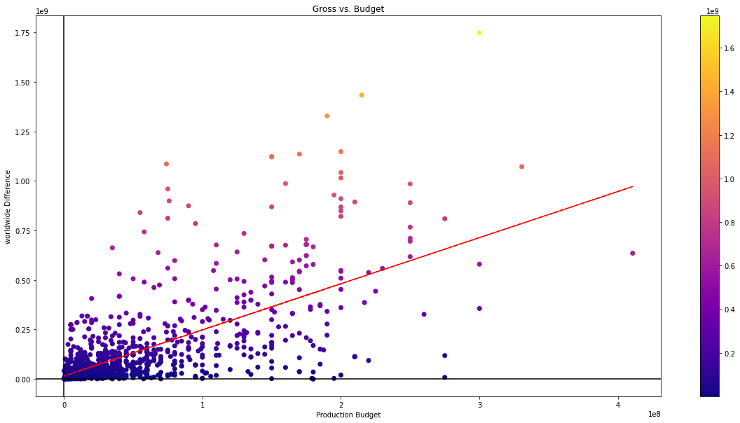
Insight #B
Looking at the relationship of all films that had a world wide profit greater than zero versus their allocated budget, we can see the relationship between the two categories is similar to the first round of analysis.

Slide 14
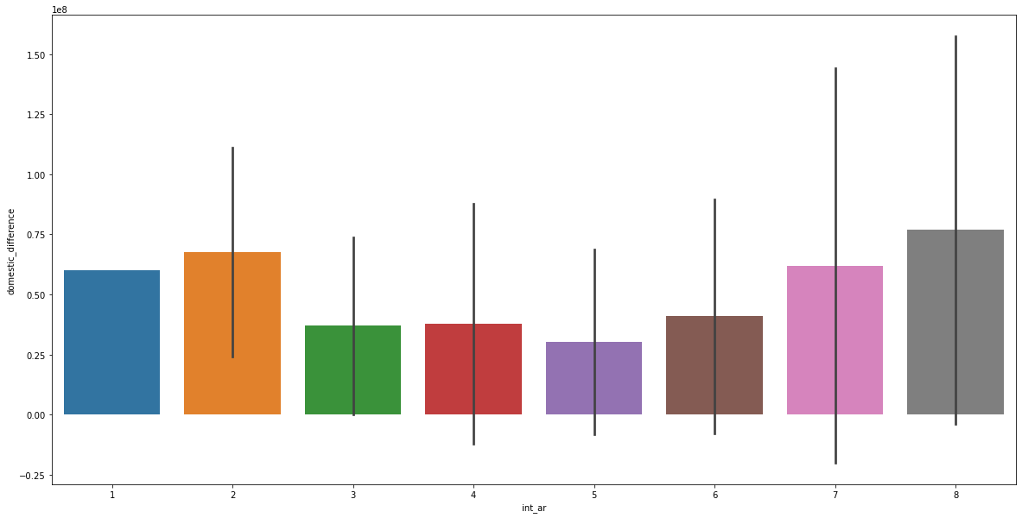
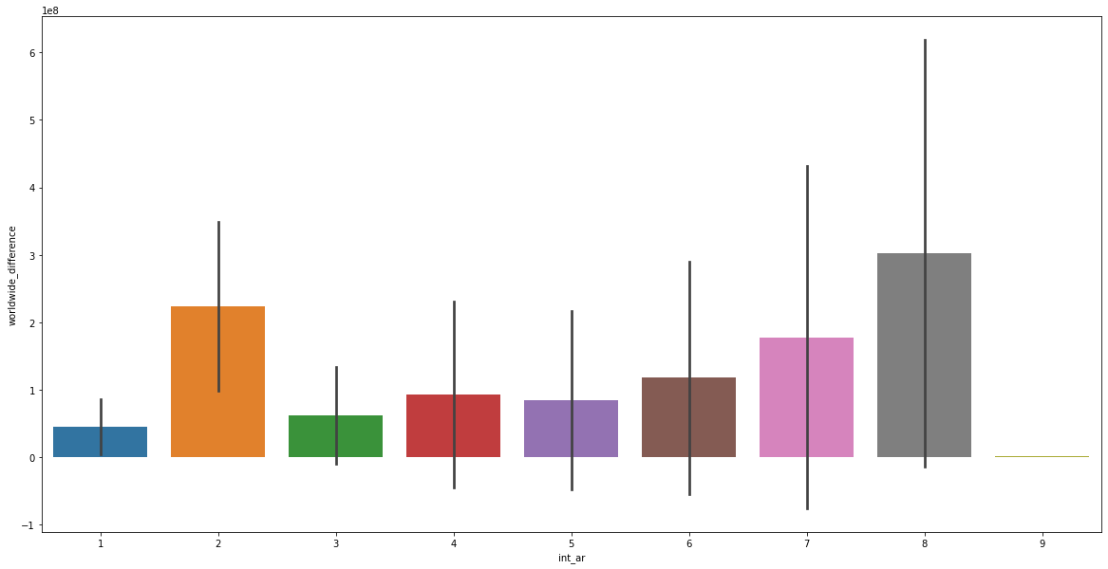
Insight #C
Now looking at which month had the highest profit for both the domestic and world wide category, we can see that after excluding all overall films with loss in each category the month’s with the highest average profit changed.
June now has the highest average domestic profit
October then has the highest average world wide profit as well.

Slide 15
Results and Conclusion
After analyzing the movie data sets, we were able to confirm the following:
1. There was a slight positive correlation between the domestic income of films versus their allocated budget. The positive correlation was also found to be much stronger when excluding films with an overall loss from the analysis.
2. There was a strong positive correlation between the world wide profit and the allocated budget for the films and the relationship was found to be as similarly strong when excluding films with an overall world wide profit loss.

Slide 16
Results and Conclusion
3. The relationship between a movies average rating versus their allocated budget was also found to be slightly positive.
4. When looking at which month’s had the highest average domestic and world wide profit, it was found that May had the highest average domestic profit with August having the highest average world wide profit.
5. Yet, it was found that June had the highest average domestic profit with October having the highest world wide profit when excluding films with an overall loss from the analysis.

Slide 17
Final Thoughts
Profit V Budget
Release Date
In response, to the initial business problem presented by Microsoft’s new endeavor. It would be wise to keep in mind that there were positive correlations between movies profit and allocated budget.
It would also be wise to keep in mind that the release date of films would be important in increasing the studio’s chance at profit and overall success.

Slide 18
Project Recommendations
While the information brought forth and information discovered.
It is highly suggested to keep in mind the content of data analyzed and used for this project.
Further areas to analyze and incorporate into current discoveries would include the following:
- Looking at location of released movies.
- Looking at the number of movies released in each month and the impact on current findings.
- Looking at the director’s and studio’s relationship to a movies overall profit.
- More information would prove useful in re-evaluating current findings.

Slide 19
Questions?

Slide 20
Thank you!

